Slide 1
Best place to live in California

Slide 2
Objective of the project
Help in locating the best place live in the Golden State based on income and available schools

Slide 3
Getting data for the project
APIs:
GreatSchools.org
US Census
American FactFinder

Slide 4
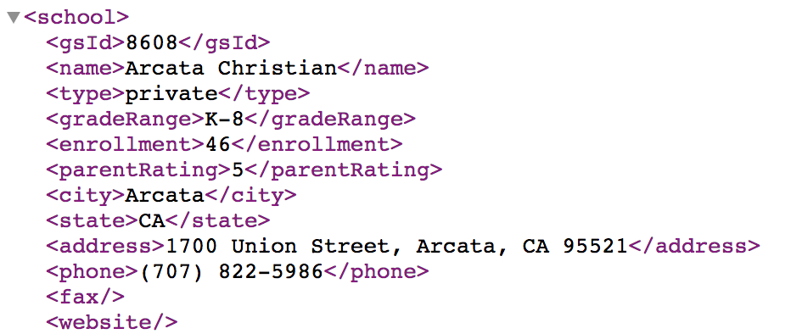
Creating database
Web scrapping GreatSchool website by city names
Use MongoDB to process the school data
Convert MongoDB output to CSV and JSON file
Re-use squlite database to run python apps

Slide 5
website
Add link

